Slide 1
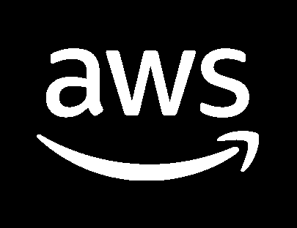




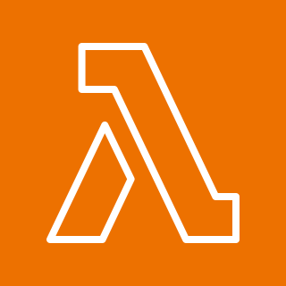
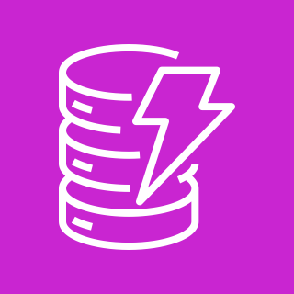





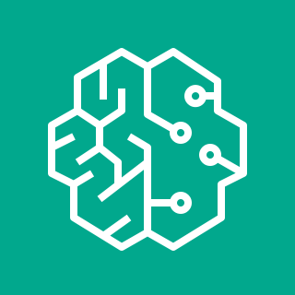



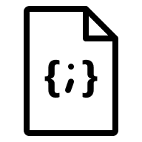


Guidance for Open Source
3D Reconstruction Toolbox for Gaussian Splats on AWS
This event-driven, serverless architecture enables the generation of realistic 3D content through cutting-edge, open source rendering techniques.
1
User authenticates to AWS Identity and Access Management (IAM) via AWS Tools and SDKs.
The configuration and input media is uploaded to a dedicated Amazon Simple Storage Service (S3) bucket location. This can be done using a Gradio interface and AWS Software Development Kit (SDK).
Optionally, the solution supports external job submission by uploading a ‘.json’ job configuration file and media into a designated S3 bucket location.
The job json file uploaded to the bucket will trigger an Amazon Simple Notification Service (SNS) message that will invoke an initialization AWS Lambda function.
The initialization Lambda function will perform input validation and set appropriate variables for the state machine.
The workflow job record will be created in Amazon DynamoDB job table.
The initialization Lambda function will invoke an AWS Step Functions State Machine to handle the entire workflow job.
An Amazon SageMaker Training Job will be submitted synchronously using the state machine built-in wait until completion mechanism.
The Amazon Elastic Container Registry (ECR) container image and S3 model artifacts will be used to spin up a new graphics processing unit (GPU) container. The instance type is determined by the job json configuration.
The GPU container will run the entire pipeline.
Upon job completion, a final Lambda function will complete the workflow job by updating the job metadata in DynamoDB and notifying the user via email upon completion using SNS.
Internal workflow parameters are stored in Parameter Store during solution deployment to decouple services.
Amazon CloudWatch is used to monitor the training logs, surfacing errors to the user.
2
2
AWS Cloud
Workflow Input
& UI
3
AWS Region
4
5
6
1
4
Authenticated IAM user
AWS
Tools and SDKs
Amazon
Simple Storage Service
AWS
Lambda
Amazon
DynamoDB
AWS
Identity and Access Management (IAM)
5
7
AWS Step Functions
6
3
AWS
Management Console
8
9
Amazon
Elastic Container Registry
10
7
Amazon
SageMaker
Training Job
GPU
Container
8
External Job Submission
Media (video, images,
3D poses)
Amazon
Simple Storage Service
12
9
Parameter Store
11
Amazon
DynamoDB
10
Workflow JSON Input
13
AWS
Lambda
11
Amazon CloudWatch
Amazon
Simple Notification Service
12
13

Slide 2
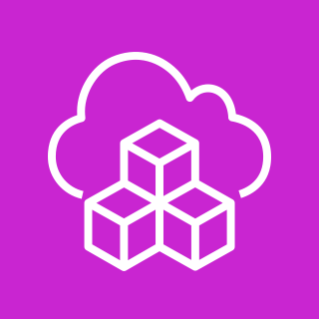


Guidance for Open Source
3D Reconstruction Toolbox for Gaussian Splats on AWS
This event-driven, serverless architecture enables the generation of realistic 3D content through cutting-edge, open source rendering techniques.
System administrator deploys solution to AWS account and region using AWS Cloud Development Kit or Terraform.
The first stack to deploy will create all of the AWS resources needed to host the solution. This includes creating S3 buckets, Lambda functions, a DynamoDB table, IAM permissions, ECR image, resource ARNs in Parameter Store, and an SNS topic is created.
Once the base stack has been deployed, the post deploy stack should be deployed. This stack will build docker container, push it to ECR, and also build and push the models used during training into S3.
1
AWS Cloud
AWS Region
1
Solution Deployment
2
Base Stack (create resources)
2
AWS
Lambda
Amazon
DynamoDB
Parameter
Store
AWS
Cloud Development Kit
Amazon
Simple Storage
Service
Amazon
Elastic Container
Registry
AWS
Identity and
Access Management (IAM)
Amazon
Simple Notification
Service
Admin
IAM user
-OR-
3
3
Post Deploy Stack (build container, push to ECR, upload model to S3)
Amazon
Simple Storage Service
Amazon
Elastic Container Registry

